Slide 1


Fundamentals of Web Development
Third Edition by Randy Connolly and Ricardo Hoar
Chapter 5b
Working with Databases
Copyright © 2021, 2018, 2015 Pearson Education, Inc. All Rights Reserved

Slide 2
In this chapter you will learn . . .
The role that databases play in web development
What are the most common commands in SQL
How to access SQL databases in PHP
How NoSQL database systems work
How to work with NoSQL databases using Node
What is GraphQL

Slide 3
Databases and Web Development
In this book, the relational DBMS used will be either SQLite or MySQL ( or MariaDB) There are many other open-source and proprietary relational DBMS alternates to MySQL, such as PostgreSQL, Oracle Database, IBM DB2, and Microsoft SQL Server.
In addition to relational database systems, there are non-relational models for database systems that will also be explored in this chapter. These systems are usually categorized with the term NoSQL and includes systems such as Cassandra and MongoDB
Databases provide data integrity (accuracy and consistency of data) and can reduce the amount of data duplication

Slide 4
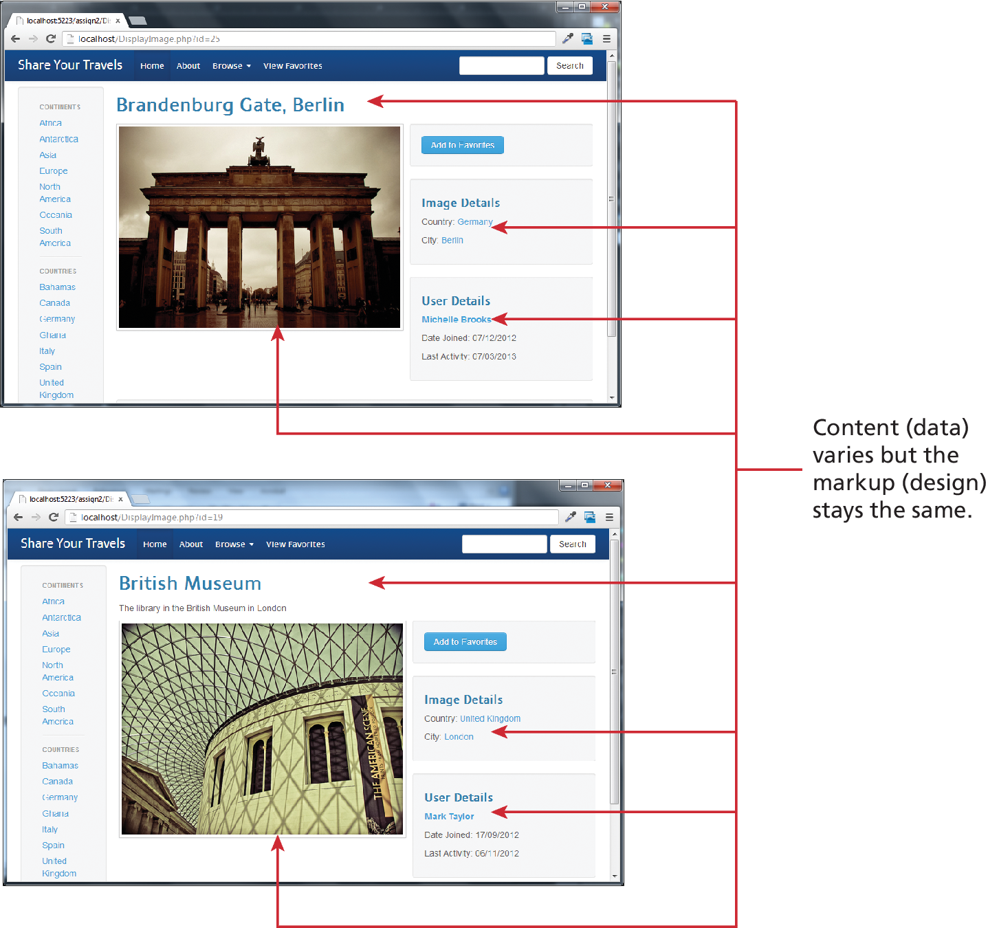
The Role of Databases in Web Development
Databases provide a way to implement an important software design principles: namely, that one should separate that which varies from that which stays the same.
On the web the visual appearance (i.e., the HTML and CSS) is that which stays the same, while the data content is that which varies.

Slide 5
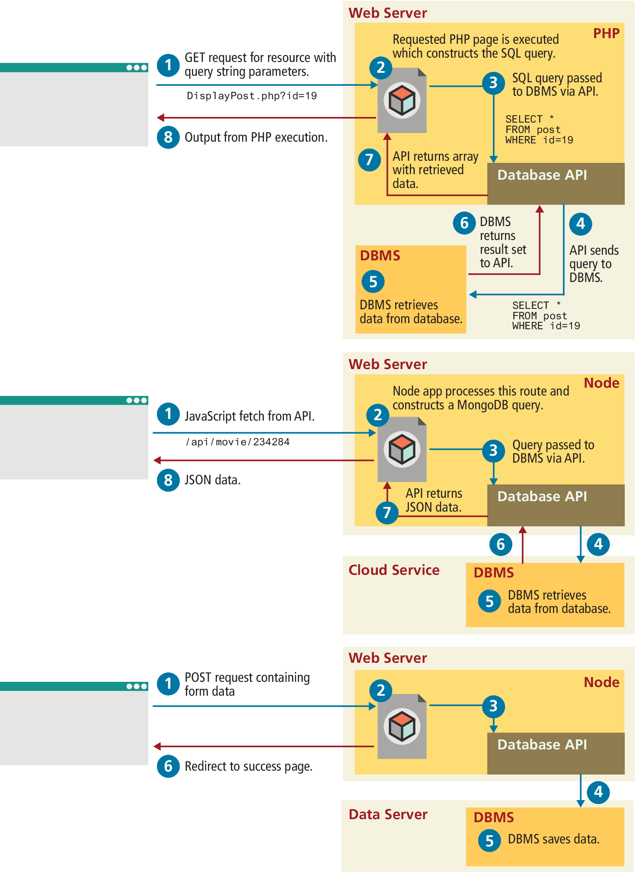
How websites use databases

Slide 6
Managing Databases
Running the SQLite lab exercises for PHP and Node, you don't actually have to install anything, since it is a file-based, in-memory database.
To run the PHP exercises in this chapter's lab, you will need access to MySQL. If you have installed XAMPP to run your PHP, MySQL is already installed.
To run the Node exercises in this chapter, you will either need to install MongoDB or make use of a cloud service such as MongoDB Atlas.

Slide 7
Managing Databases (Tools)
The tools available to you range from the original command-line approach, through to the modern workbench, where an easy-to-use toolset supports the most common operations.
Command-Line Interface
phpMyAdmin
MySQL Workbench
SQLite Tools
MongoDB Tools

Slide 8
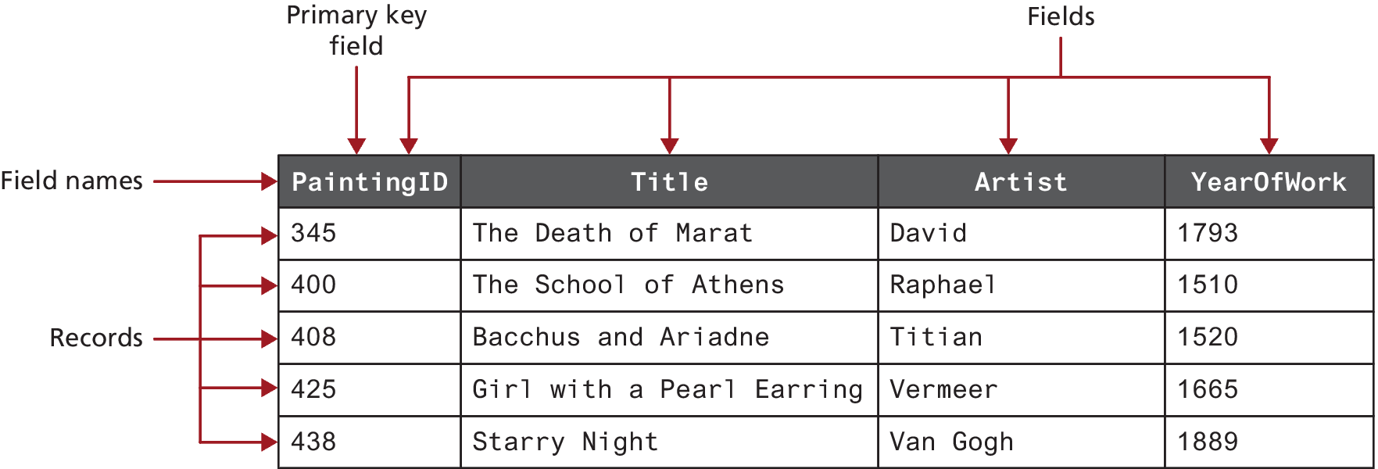
SQL
A table is the principal unit of storage in a database. It is a two-dimensional container for data that consists of records (rows); each record has the same number of columns. These columns are called fields, which contain the actual data. Each table will have a primary key—a field (or sometimes combination of fields) that is used to uniquely identify each record in a table.

Slide 9

Table Design
Data types that are akin to those in a statically typed programming language and contribute to data integrity. (BIT,BLOB,CHAR(n), DATE,FLOAT,INT,VARCHAR(n))
As we discuss database tables and their design, it will be helpful to have a condensed way to visually represent a table. It is normally enough to see the field names, and perhaps their data types.

Slide 10
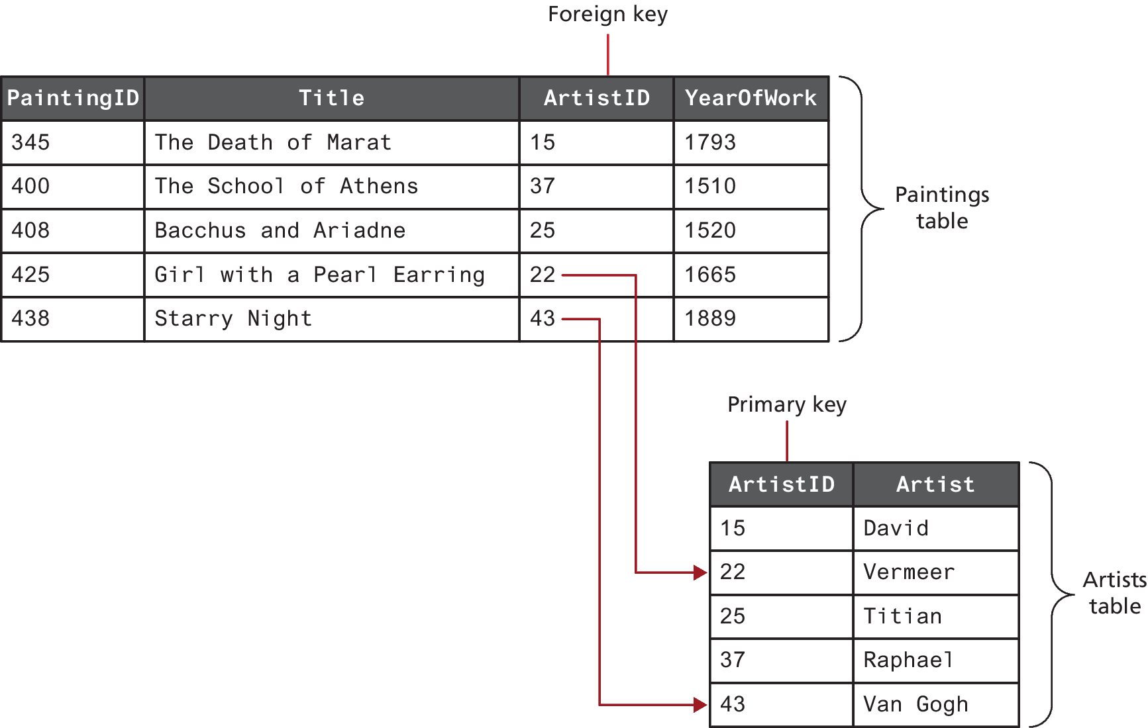
Foreign Key
Foreign key relates a field in one table to a primary key in another table
Tables that are linked via foreign keys are said to have a relationship.

Slide 11
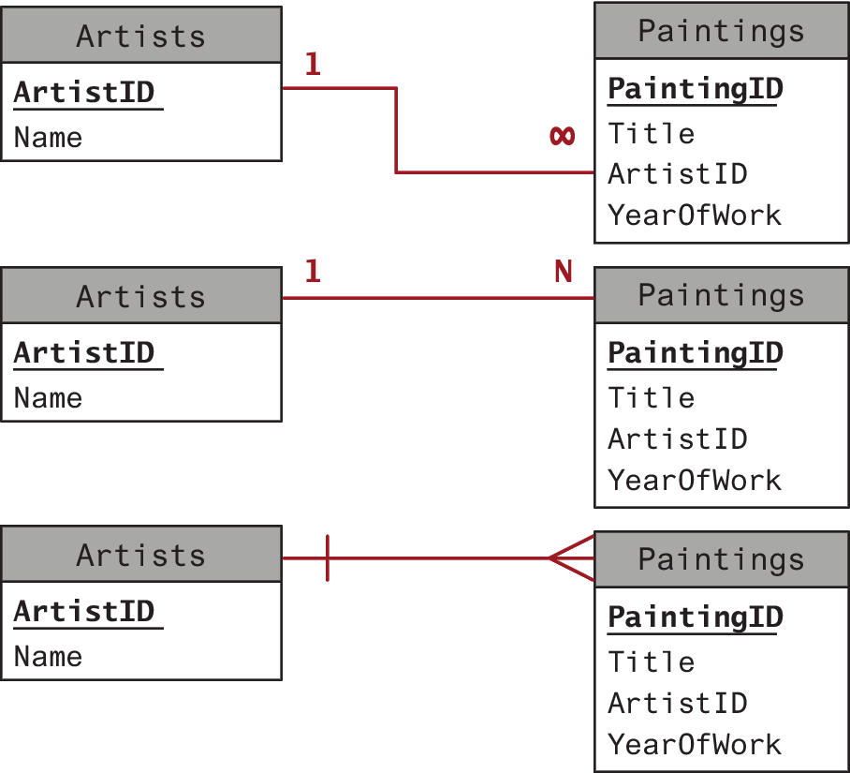
Table relationships
Most often, two related tables will be in a one-to-many relationship.
There are two other table relationships: the one-to-one relationship and the many-to-many relationship.

Slide 12
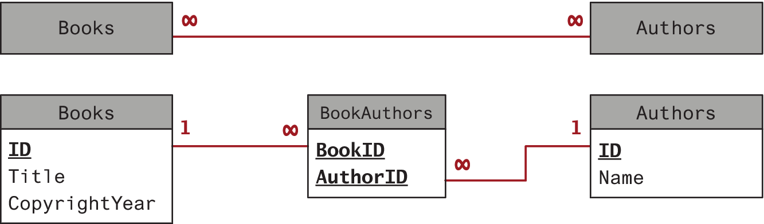
Composite Key
Note that in this example, the two foreign keys in the intermediate table are combined to create a composite key. Alternatively, the intermediate table could contain a separate primary key field.

Slide 13
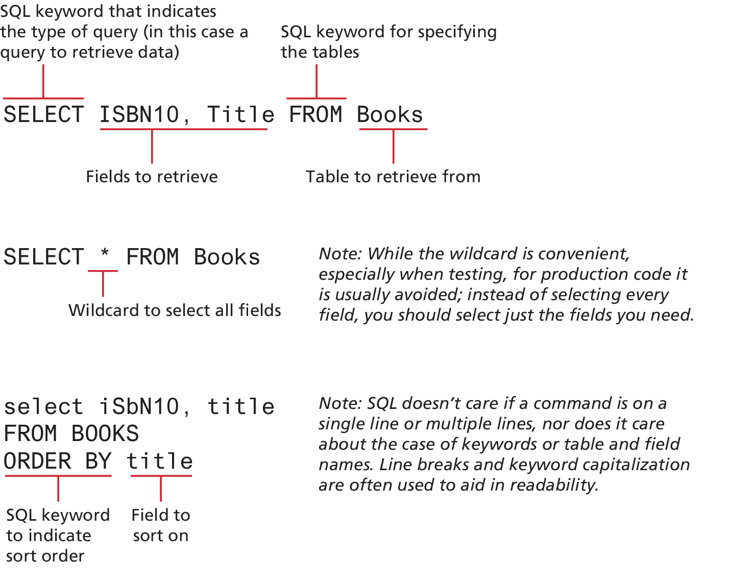
SELECT Statement
The SELECT statement is used to retrieve data from the database. The term query is sometimes used as a synonym for running a SELECT statement
The result of a SELECT statement is a block of data typically called a result set which can be ordered

Slide 14
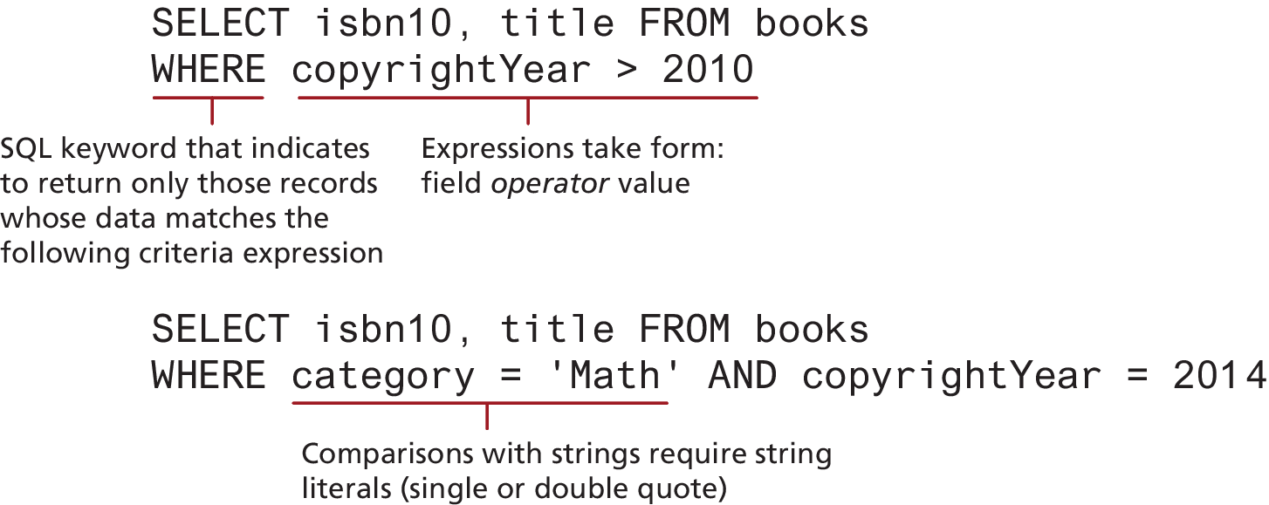
WHERE Clause
The WHERE keyword is used to supply a comparison expression that the data must match in order for a record to be included in the result set.

Slide 15
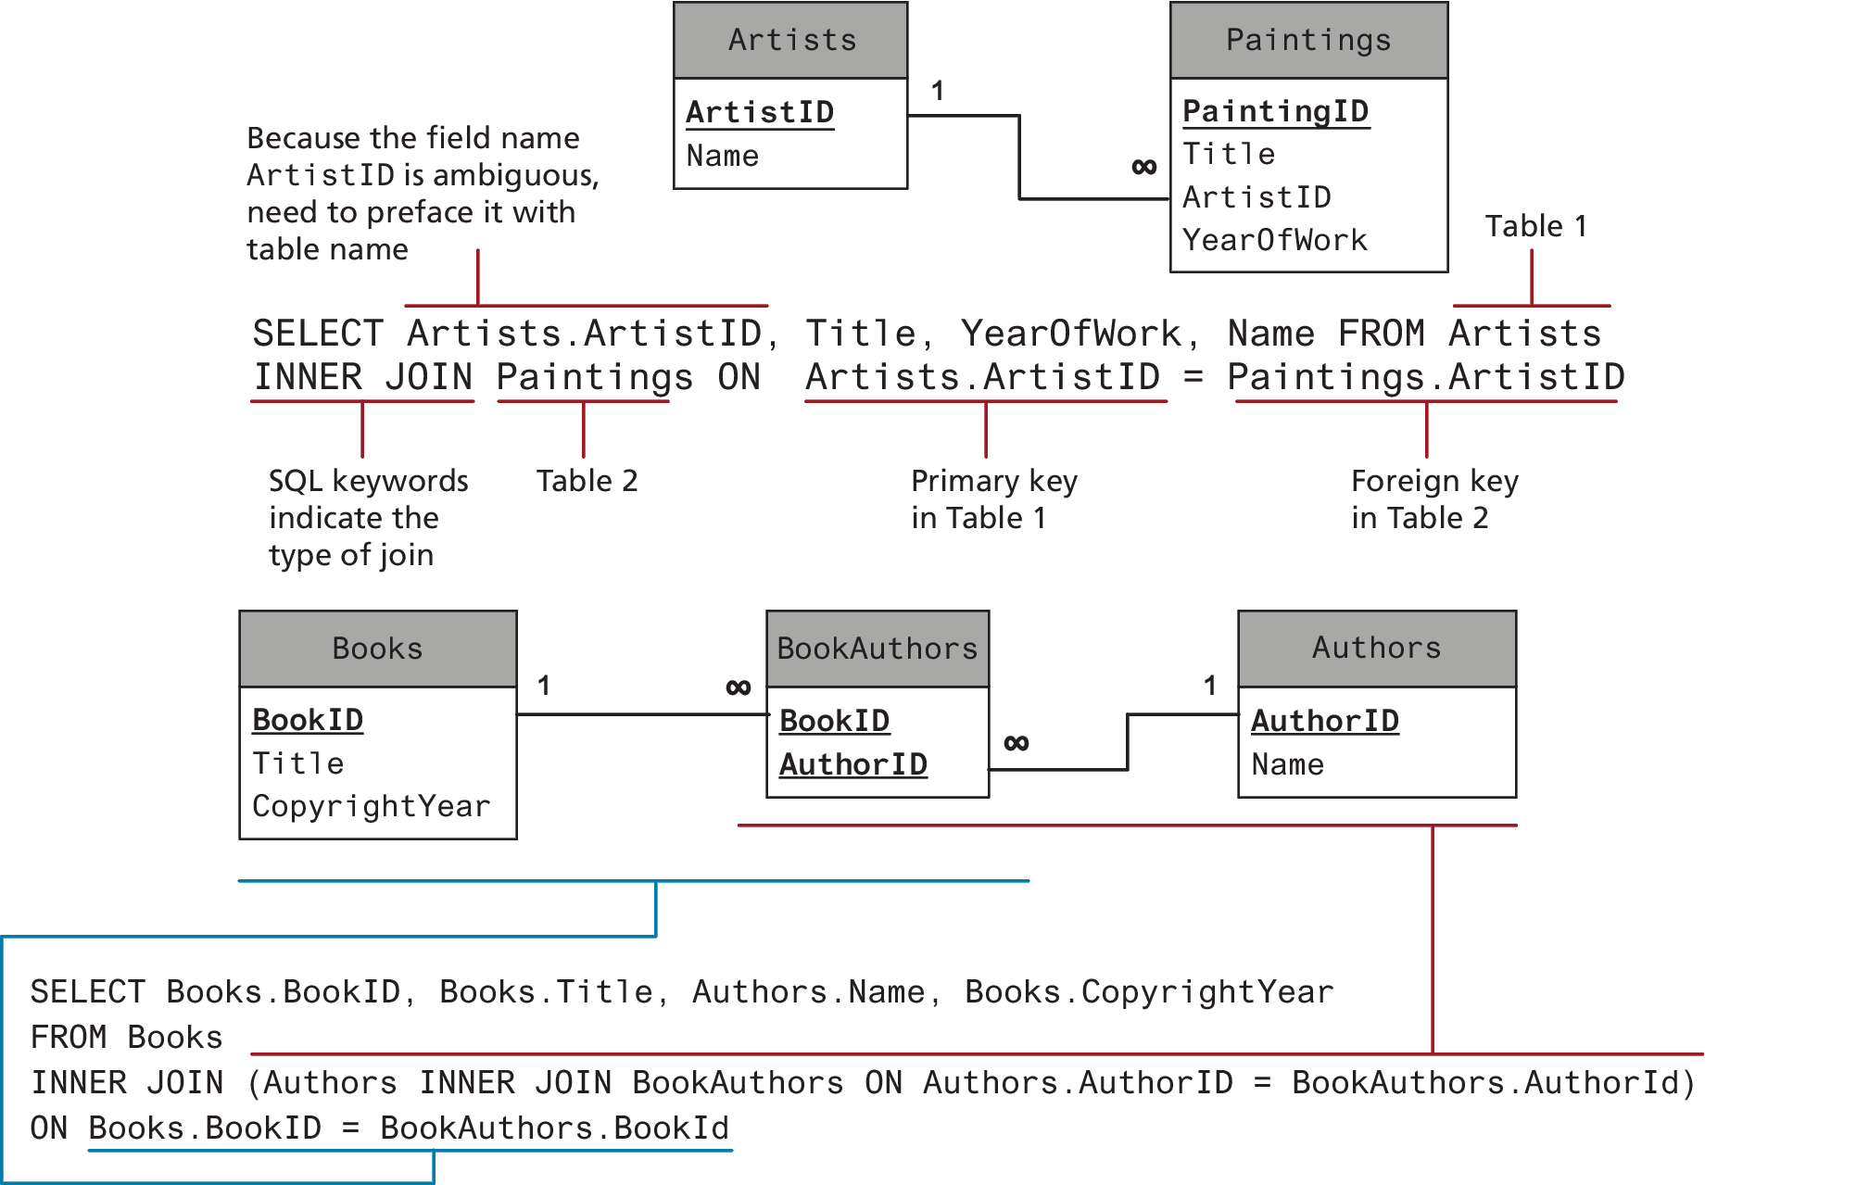
Join
Retrieving data from multiple tables is more complex and requires the use of a join.
When two tables are joined via an inner join, records are returned if there is matching data (typically from a primary key in one table and a foreign key in the other) in both tables

Slide 16
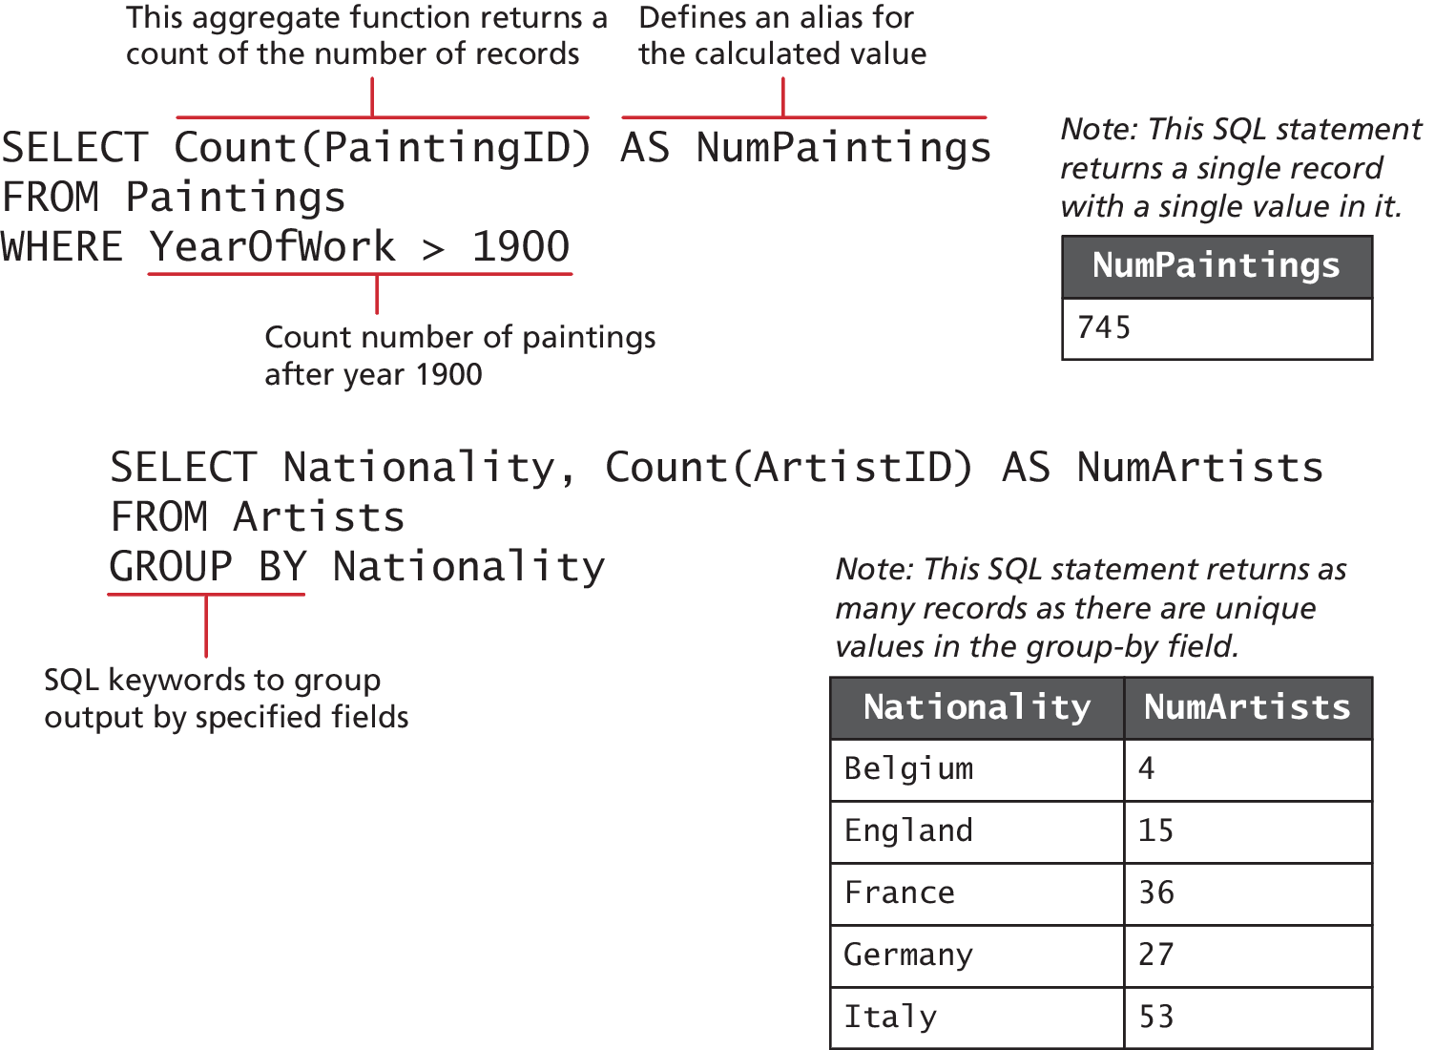
Grouping
When you don’t want every record in your table but instead want to perform some type of calculation on multiple records and then return the results you use one or more aggregate functions such as SUM() or COUNT(); these are often used in conjunction with the GROUP BY keywords.

Slide 17
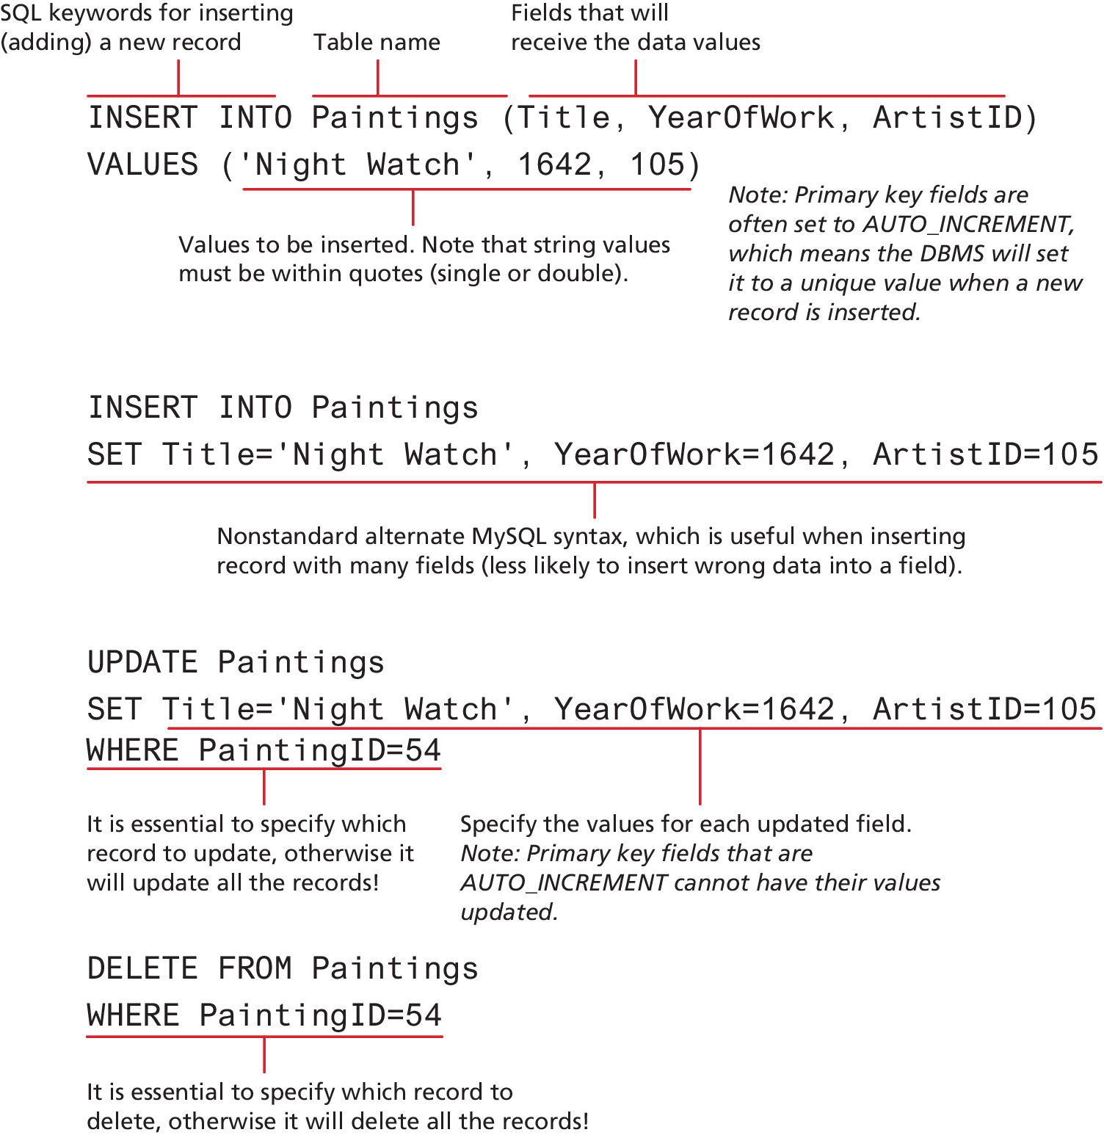
INSERT Statements

Slide 18
UPDATE and DELETE Statements

Slide 19
Transactions
A transaction refers to a sequence of steps that are treated as a single unit, and provide a way to gracefully handle errors and keep your data properly consistent when errors do occur.
Local transaction support in the DBMS can handle the problem of an error with START TRANSACTION, COMMIT, and ROLLBACK commands.
/* By starting the transaction, all database modifications within will only be permanently saved in the database if they all work */
START TRANSACTION
INSERT INTO orders . . .
INSERT INTO orderDetails . . .
UPDATE inventory . . .
/* if we have made it here everything has worked so commit changes */
COMMIT
LISTING 14.2 SQL commands for transaction processing

Slide 20
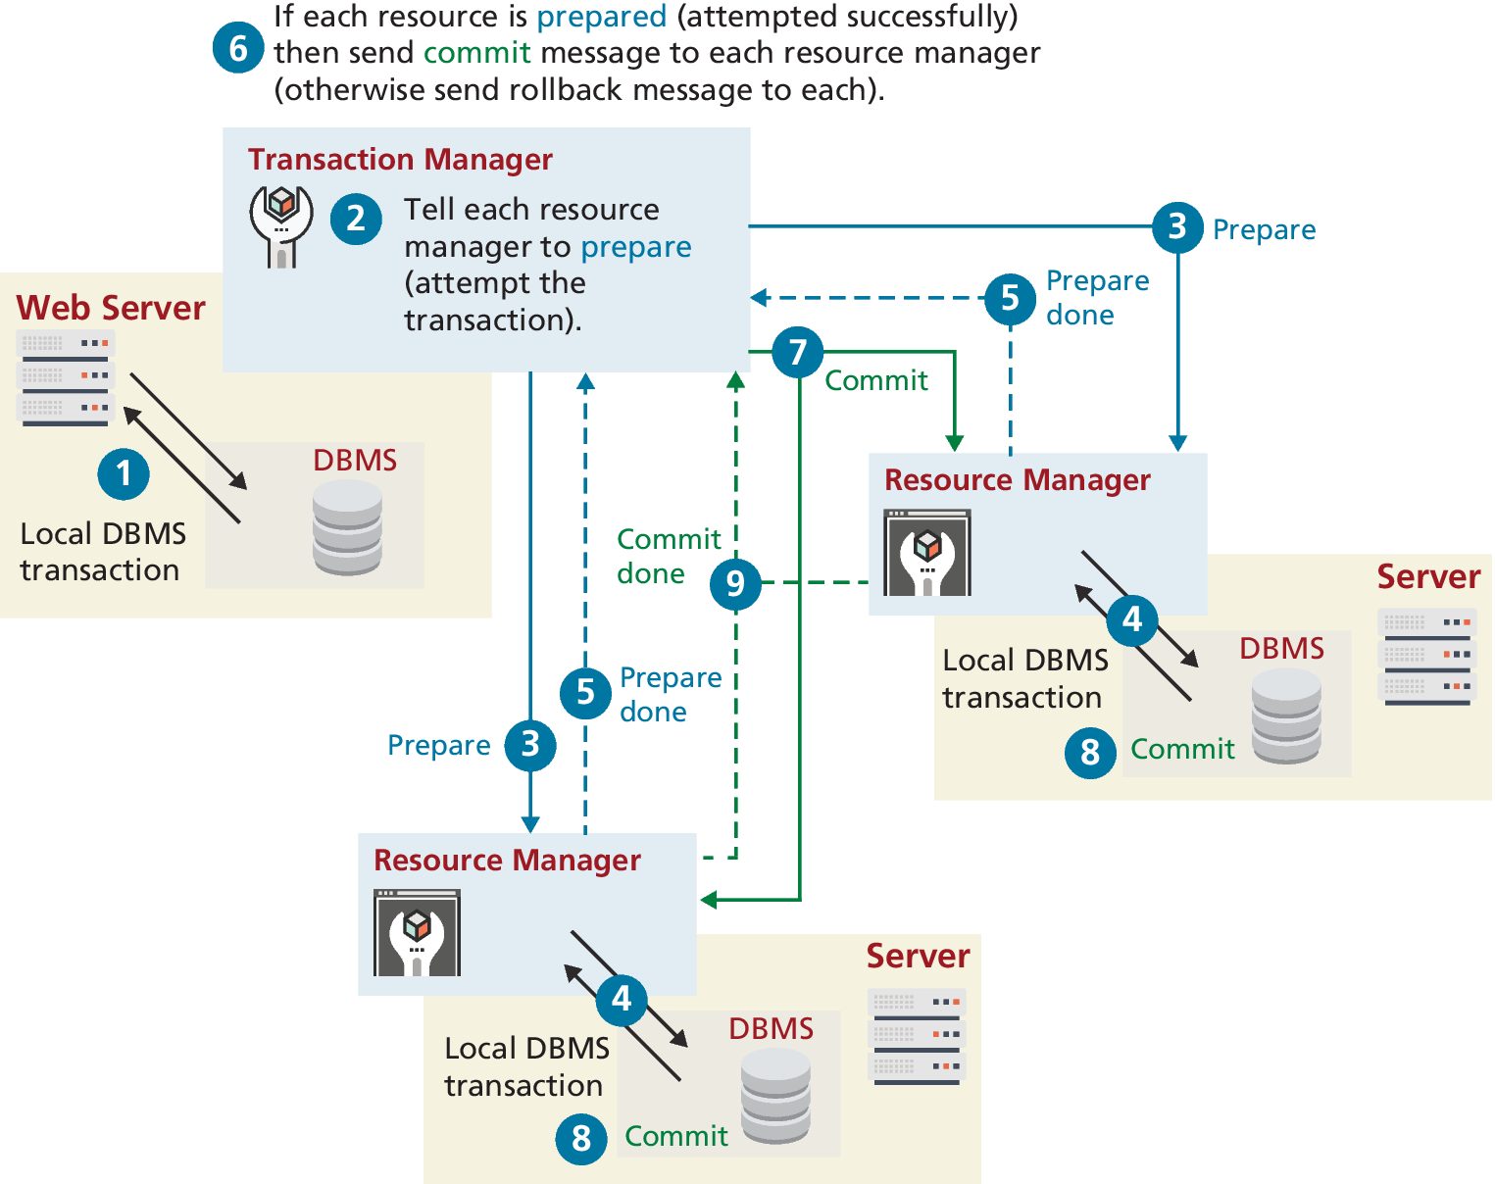
Distributed Transactions
Transactions involving multiple hosts, several of which we may have no control over; are typically called distributed transactions.
A distributed transaction not only requires local database writes, but also the involvement of an external credit card processor, an external legacy ordering system, and an external shipping system. Because there are multiple external resources involved, distributed transactions are much more complicated than local transactions.

Slide 21
Data Definition Statements
All of the SQL examples that you will use in this book are examples of the data manipulation language features of SQL, that is, SELECT, UPDATE, INSERT, and DELETE. There is also a Data Definition Language (DDL) in SQL, which is used for creating tables, modifying the structure of a table, deleting tables, and creating and deleting databases.
Most tools such as the phpMyAdmin, offer interfaces that allow you to manipulate table indirectly through a GUI.

Slide 22
Database Indexes and Efficiency
Consider the worst-case scenario for searching where we compare a query against every single record. If there are n elements, we say it takes O(n) time to do a search (we would say “Order of n”).
In comparison, a balanced binary tree data structure can be searched in O(log2 n) time.
It is possible to achieve O(1) search speed—that is, one operation to find the result—with a hash table data structure.
No matter which data structure is used, the application of that structure to ensure results are quickly accessible is called an index.

Slide 23
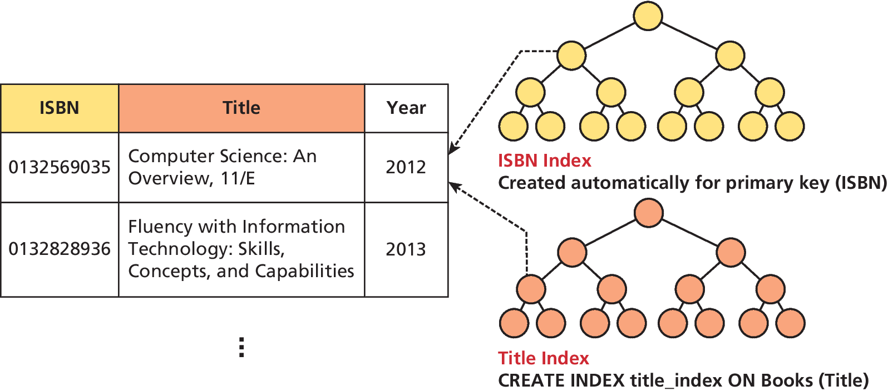
Database Index

Slide 24
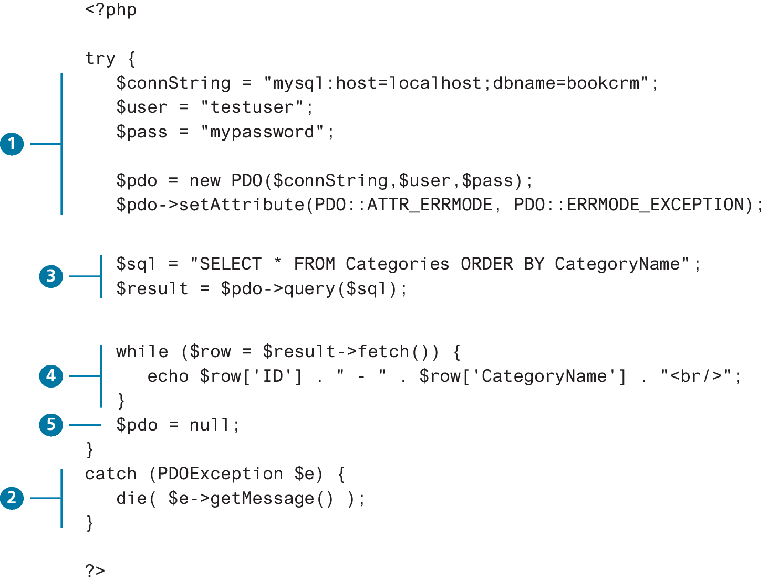
Working with SQL in PHP
With PDO, the basic database connection algorithm is:
Connect to the database.
Handle connection errors.
Execute the SQL query.
Process the results.
Free resources and close connection.

Slide 25
Connecting to a Database
With MySQL databases, you supply:
the host or URL of the database server, the
database name, and
the database user name and password.
With SQLite databases, you only need to supply the path to the file:
$pdo = new PDO('sqlite:./movies.db');
// modify these variables for your installation
$connectionString = "mysql:host=localhost;dbname=bookcrm";
// you may need to add this if db has UTF data
$connectionString .= ";charset=utf8mb4;";
$user = "testuser";
$pass = "mypassword";
$pdo = new PDO($connectionString,
$user, $pass);
LISTING 14.4 Connecting to a database with PDO (object-oriented)

Slide 26
Storing Connection Details
A common solution is to store connection details in defined constants within a file named config.inc.php.
require_once('protected/config.inc.php’); $pdo = new PDO(DBCONNSTRING,DBUSER,DBPASS);
<?php
define('DBHOST', 'localhost');
define('DBNAME', 'bookcrm');
define('DBUSER', 'testuser');
define('DBPASS', 'mypassword');
define('DBCONNSTRING',"mysql:host=". DBHOST. ";dbname=". DBNAME);
?>
LISTING 14.2 Defining connection details via constants in a separate file (config.inc.php)

Slide 27
Handling Connection Errors
Unfortunately not every database connection always works. The approach in PDO for handling connection errors uses try...catch exception- handling blocks.
It should be noted that PDO has three different error-handling approaches/modes.
try {
$pdo = new PDO(DBCONNSTRING,DBUSER,DBPASS);
...
}
catch (PDOException $e) {
die( $e->getMessage() );
}
LISTING 14.7 Handling connection errors with PDO

Slide 28
Executing the Query
If the connection to the database is successfully created, then you are ready to construct and execute the query.
$sql = "SELECT * FROM Categories ORDER BY CategoryName";
$result = $pdo->query($sql);
LISTING 14.9 Executing a SELECT query
$sql = "DELETE FROM artists WHERE LastName = 'Connolly'";
// returns number of rows that were deleted
$count = $pdo->exec($sql);
LISTING 14.10 Executing a DELETE query

Slide 29
Processing the Query Results
If you are running a SELECT query, then you will want to do something with the retrieved result set, such as displaying it, or performing calculations on it, or searching for something in it.
$sql = "SELECT * FROM Paintings ORDER BY Title";
$result = $pdo->query($sql);
// fetch a record from result set into an associative array
while ($row = $result->fetch()) {
// the keys match the field names from the table
echo $row['ID']. " - ". $row['Title’];
echo "<br/>";
}
LISTING 14.11 Looping through the result set

Slide 30
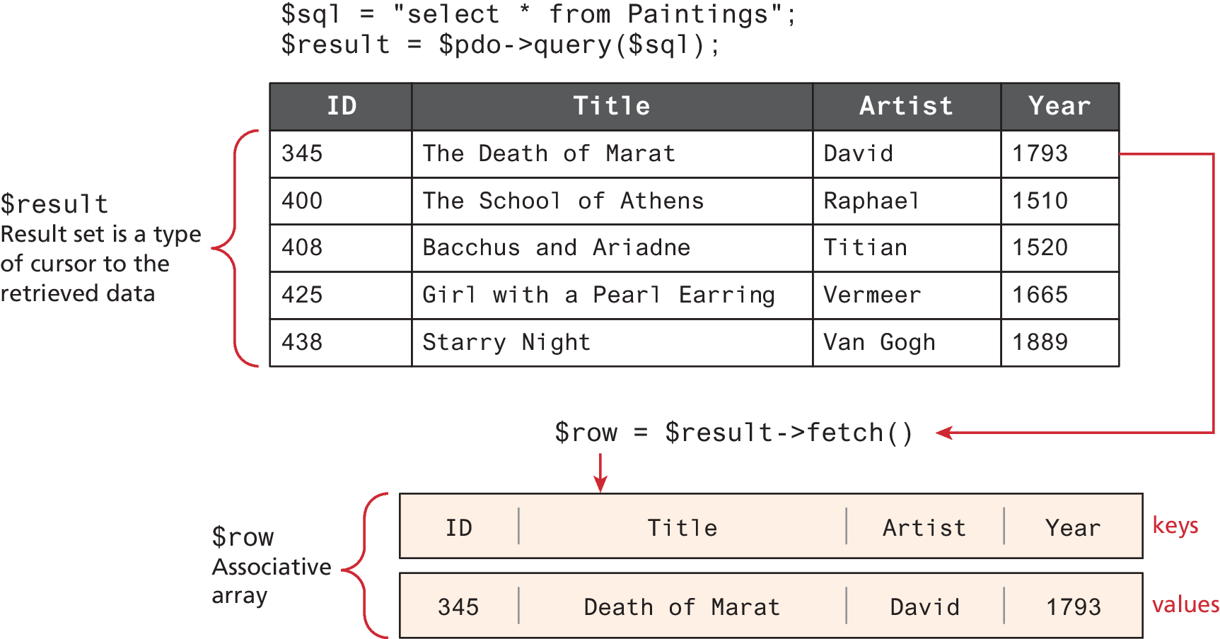
Fetching from a result set

Slide 31
Fetching into an Object
Given the following simple class we can have PHP populate an object of type Book
class Book {
public $ID;
public $Title;
public $CopyrightYear;
public $Description;
}
$sql = "SELECT * FROM Books";
$result = $pdo->query($sql);
// fetch a record into an object of type Book
while ( $b = $result->fetchObject('Book') ) {
// the property names match the table field names
echo 'ID: '. $b->ID . '<br/>’;
echo 'Title: '. $b->Title . '<br/>’;
echo 'Year: '. $b->CopyrightYear . '<br/>’;
echo 'Description: '. $b->Description . '<br/>’;
echo '<hr>';
}
LISTING 14.13 Populating an object from a result set (PDO)

Slide 32
Freeing Resources and Closing Connection
When you are finished retrieving and displaying your requested data, you should release the memory used by any result sets and then close the connection so that the database system can allocate it to another process.
try {
$pdo = new PDO(DBCONNSTRING,DBUSER,DBPASS);
...
// closes connection and frees the resources used by the PDO object
$pdo = null;
}
LISTING 14.15 Closing the connection

Slide 33
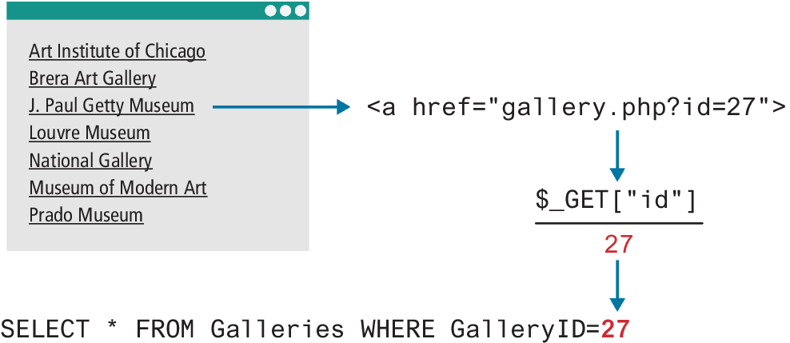
Working with Parameters
We can use the same page design to display different data records
How does a PHP page “know” which data record to display?
query string parameters
$pdo = new PDO(DBCONNSTRING,DBUSER,DBPASS);
$sql = "SELECT * FROM Galleries WHERE GalleryID=". $_GET["id"];
$result = $pdo->query($sql);
LISTING 14.16 Integrating user input into a query (first attempt)

Slide 34
Sanitizing User Data
The last example is vulnerable to SQL injection attack (Chapter 16)
Sanitization uses capabilities built into database systems to remove any special characters from a desired piece of text.
In MySQL, user inputs can be partly sanitized using the quote() method.
However, it is recommended that you use prepared statements.

Slide 35
Prepared Statements
A prepared statement is actually a way to improve performance for queries that need to be executed multiple times.
// retrieve parameter value from query string
$id = $_GET['id’];
/* method 1 – notice the ? parameter */
$sql = "SELECT Title, CopyrightYear FROM Books WHERE ID = ?";
$statement = $pdo->prepare($sql);
$statement->bindValue(1, $id); // bind to the 1st ? parameter
$statement->execute();
/* method 2 */
$sql = "SELECT Title, CopyrightYear FROM Books WHERE ID = :id";
$statement = $pdo->prepare($sql);
$statement->bindValue(':id', $id);
$statement->execute();
LISTING 14.17 Using a prepared statement

Slide 36
Named Parameters
A named parameter assigns labels in prepared SQL statements which are then explicitly bound to variables in PHP, reducing opportunities for error.
It is also possible to pass in parameter values within an array to the execute() method and cut out the calls to bindValue()
/* technique named parameters */
$sql = "INSERT INTO books (ISBN10, Title, CopyrightYear, ImprintId,
ProductionStatusId, TrimSize, Description) VALUES (:isbn,
:title,:year,:imprint,:status,:size,:desc) ";
$statement = $pdo->prepare($sql);
$statement->bindValue(':isbn', $_POST['isbn']);
$statement->bindValue(':title', $_POST['title']);
$statement->bindValue(':year', $_POST['year']);
$statement->bindValue(':imprint', $_POST['imprint']);
$statement->bindValue(':status', $_POST['status']);
$statement->bindValue(':size', $_POST['size']);
$statement->bindValue(':desc', $_POST['desc']);
$statement->execute();
LISTING 14.18 Using names parameters (part b)

Slide 37
Using Transactions
$pdo = new PDO($connString,$user,$pass);
// turn on exceptions so that exception is thrown if error occurs
$pdo->setAttribute(PDO::ATTR_ERRMODE, PDO::ERRMODE_EXCEPTION);
...
try {
// begin a transaction
$pdo->beginTransaction();
$pdo->exec("INSERT INTO Categories (CategoryName) VALUES ('Philosophy')");
$pdo->exec("INSERT INTO Categories (CategoryName) VALUES ('Art')");
// if we arrive here, it means that no exception was thrown
// which means no query has failed, so we can commit the transaction
$pdo->commit();
} catch (Exception $e) {
// we must rollback the transaction since an error occurred
// with insert
$pdo->rollback();
}
LISTING 14.20 Using transactions (PDO)

Slide 38
Designing Data Access
Database details such as connection strings and table and field names are examples of externalities. These details tend to change over the life of a web application.
Initially, the database for our website might be a SQLite database on our development machine; later it might change to a MySQL database on a data server, and even later, to a relational cloud service. Ideally, with each change in our database infrastructure, we would have to change very little in our code base.
One simple step might be to extract all PDO code into separate functions or classes and use those instead.

Slide 39
Designing Data Access (ii)
class DatabaseHelper {
public static function createConnection($values=array()) {
$connString = $values[0];
$user = $values[1];
$password = $values[2];
$pdo = new PDO($connString,$user,$password);
$pdo->setAttribute(PDO::ATTR_ERRMODE, PDO::ERRMODE_EXCEPTION);
$pdo->setAttribute(PDO::ATTR_DEFAULT_FETCH_MODE, PDO::FETCH_ASSOC);
return $pdo;
}
public static function runQuery($pdo, $sql, $parameters=array()) {
// Ensure parameters are in an array
if (!is_array($parameters)) {
$parameters = array($parameters);
}
$statement = null;
If (count($parameters) > 0) {
// Use a prepared statement if parameters
$statement = $pdo->prepare($sql);
$executedOk = $statement->execute($parameters);
if (! $executedOk) {
throw new PDOException;
}
} else {
// Execute a normal query
$statement = $pdo->query($sql);
if (!$statement) {
throw new PDOException;
}
}
return $statement;
}
} //end class
LISTING 14.21 Encapsulating database access via a helper class

Slide 40
Designing Data Access (iii)
try {
$conn = DatabaseHelper::createConnectionInfo(array(DBCONNECTION, DBUSER, DBPASS));
$sql = "SELECT * FROM Paintings ";
$paintings = DatabaseHelper::runQuery($conn, $sql, null);
foreach ($paintings as $p) {
echo $p["Title"];
}
$sql = "SELECT * FROM Artists WHERE Nationality=?";
$artists = DatabaseHelper::runQuery($conn, $sql, Array("France"));
}
Illustrates two example uses of this class. While an improvement, we still have a database dependency in this code with the SQL statements and field names.

Slide 41
A table gateway
class PaintingDB {
private static $baseSQL = "SELECT * FROM Paintings ";
public function __construct($connection) {
$this->pdo = $connection;
}
public function getAll() {
$sql = self::$baseSQL;
$statement = DatabaseHelper::runQuery($this->pdo,
$sql, null);
return $statement->fetchAll();
}
public function findById($id) {
$sql = self::$baseSQL . " WHERE PaintingID=?";
$statement = DatabaseHelper::runQuery($this->pdo, $sql, Array($id));
return $statement->fetch();
}
public function getAllForArtist($artistID) {
$sql = self::$baseSQL . " WHERE Paintings.ArtistID=?";
$statement = DatabaseHelper::runQuery($this->pdo, $sql, Array($artistID));
return $statement->fetchAll();
}
public function getAllForGallery($galleryID) {
$sql = self::$baseSQL . " WHERE Paintings.GalleryID=?";
$statement = DatabaseHelper::runQuery($this->pdo, $sql,
Array($galleryID));
return $statement->fetchAll();
}
}
LISTING 14.22 Sample gateway class for painting table

Slide 42
NoSQL Databases
NoSQL (which stands for Not-only-SQL) is category of database software that describes a style of database that doesn’t use the relational table model of normal SQL databases.
NoSQL databases rely on a different set of ideas for data modeling that put fast retrieval ahead of other considerations like consistency.
Systems like DynamoDB, Firebase, and MongoDB now power thousands of sites including household names like Netflix, eBay, Instagram, Forbes, Facebook, and others.

Slide 43
Why (and Why Not) Choose NoSQL?
NoSQL systems handle huge datasets better than relational systems.
NoSQL databases aren’t the best answer for all scenarios. SQL databases use schemas for a very good reason: they ensure data consistency and data integrity.
The data in most NoSQL database systems is identified by a unique key. The key-value organization often results in faster retrieval of data in comparison to a relational database

Slide 44
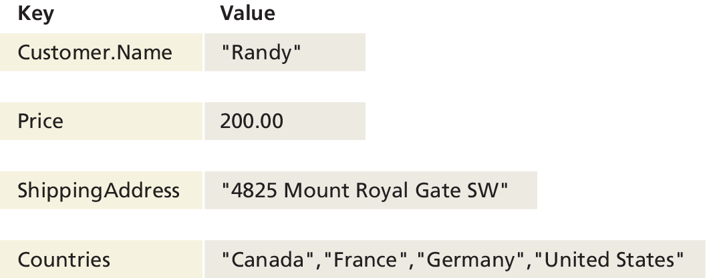
Key-Value Stores
Key-value stores alone are quite straightforward in that every value, whether an integer, string, or other data structure, has an associated key (i.e., they are analogous to PHP associative arrays)
Here every value has a key. This allows fast retrieval through means such as a hash function, and precludes the need for indexes on multiple fields as is the case with SQL

Slide 45
Document Store
Document Stores (also called document-oriented databases) associate keys with values, but unlike key-value stores, they call that value a document.
A document can be a binary file like a .doc or .pdf or a semi-structured XML or JSON document.
Most NoSQL systems are of this type. MongoDB, AWS DynamoDB, Google FireBase, and Cloud Datastore are popular examples.

Slide 46
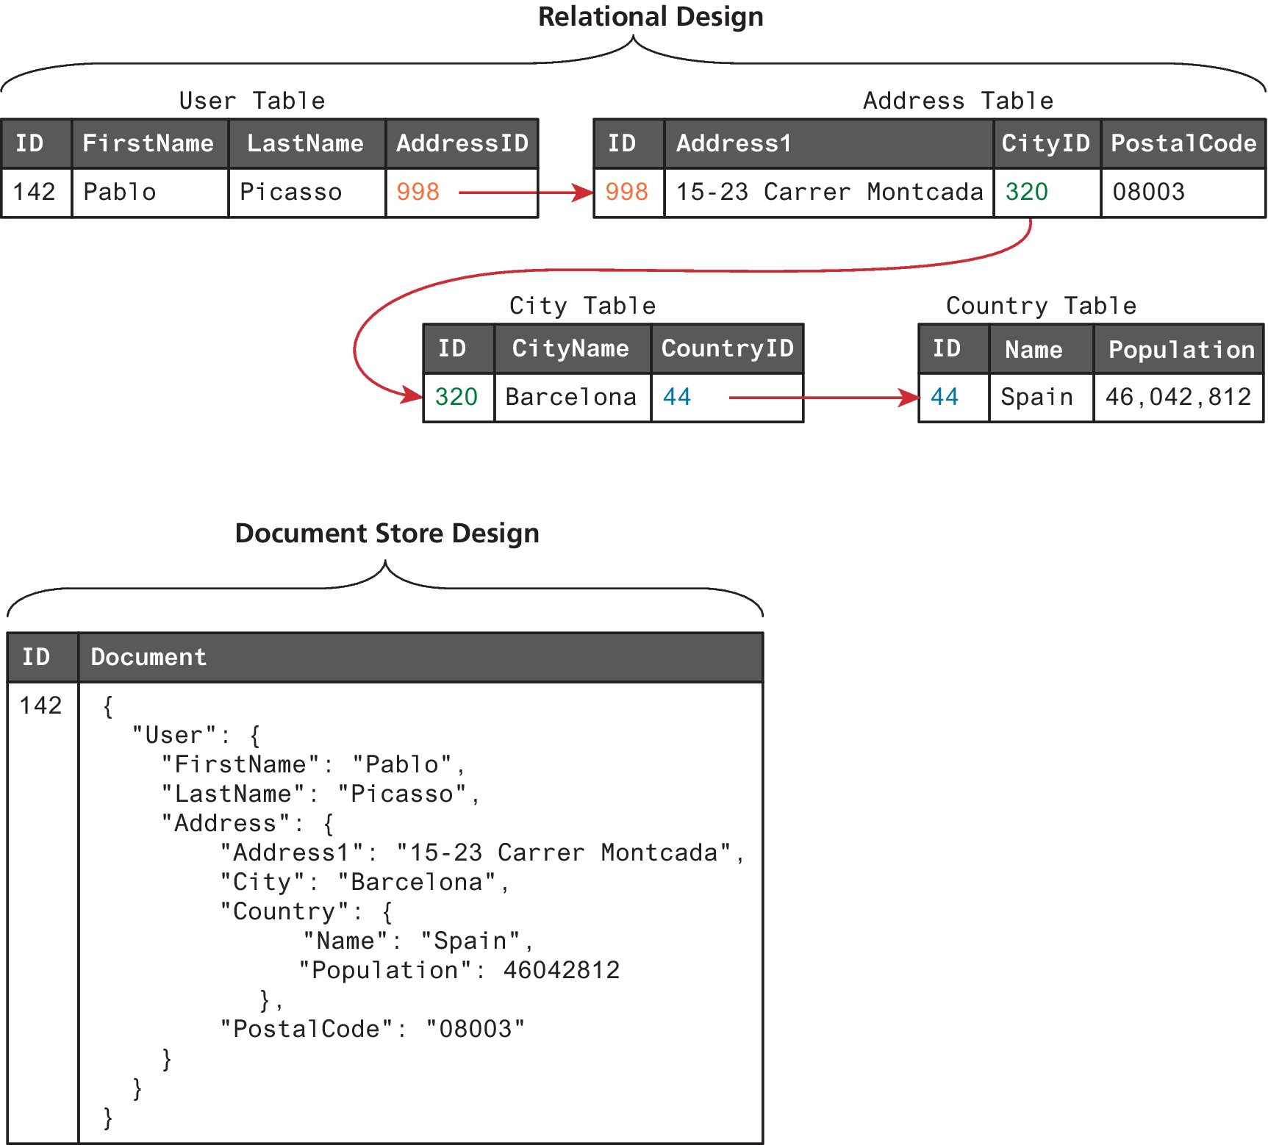
Relational data versus document store data

Slide 47
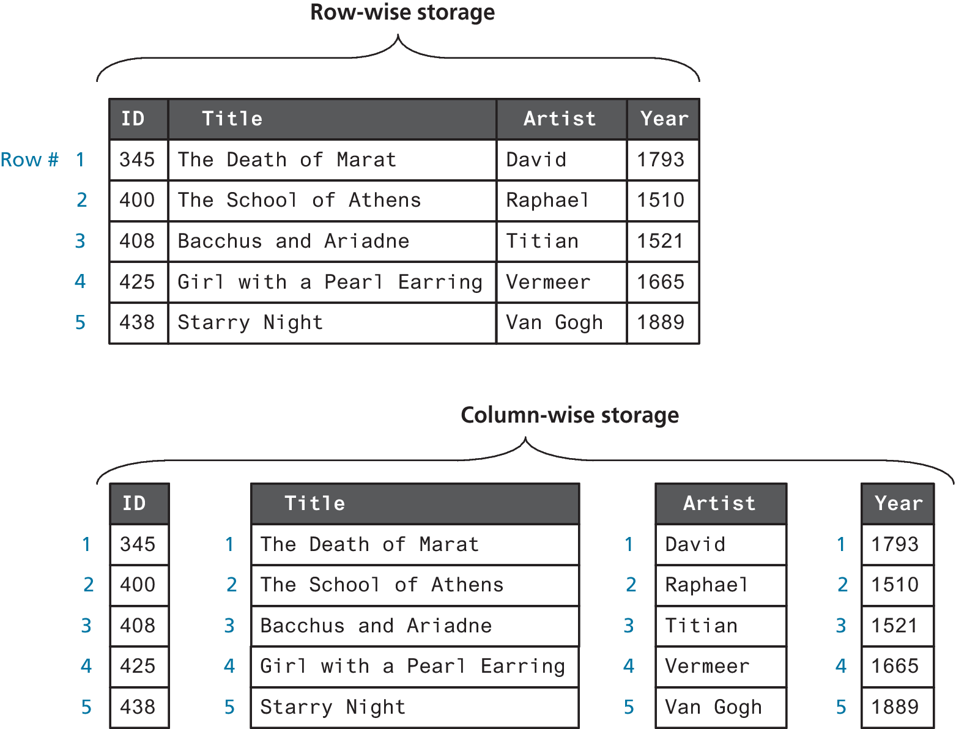
Column Stores
In traditional relational database systems, the data in tables is stored in a row-wise manner. This means that the fundamental unit of data retrieved is a row.
Column Store systems store data by column instead of by row, meaning that fetches retrieve a column of data and retrieving an entire row requires multiple operations.

Slide 48
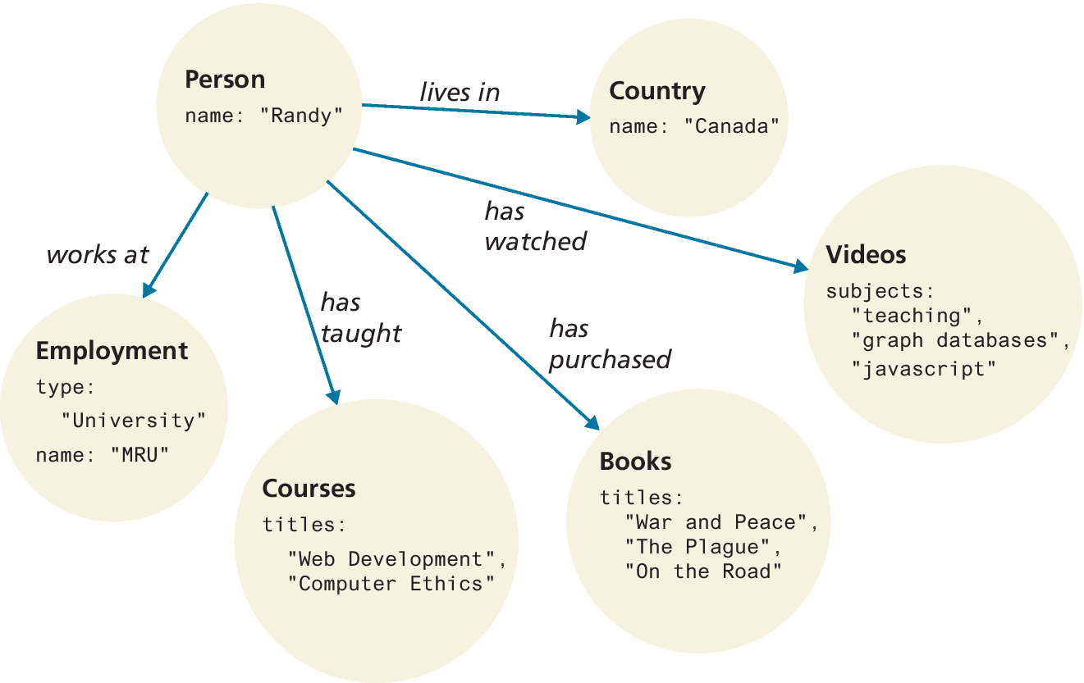
Graph Stores
In a Graph Store system (often simply called graph databases), data is represented as a network or graph of entities and their relationships.
Some examples of graph databases include Neo4j, OrientDB, and RedisGraph.

Slide 49
Working with MongoDB in Node
MongoDB MongoDB is an open-source, NoSQL, document-oriented database. It can be used with PHP, it is much more commonly used with Node
You simply package your data as a JSON object, give it to MongoDB, and it stores this object or document as a binary JavaScript object (BSON).
MongoDB does not support transactions
The ability to run on multiple servers means MongoDB can handle large datasets

Slide 50
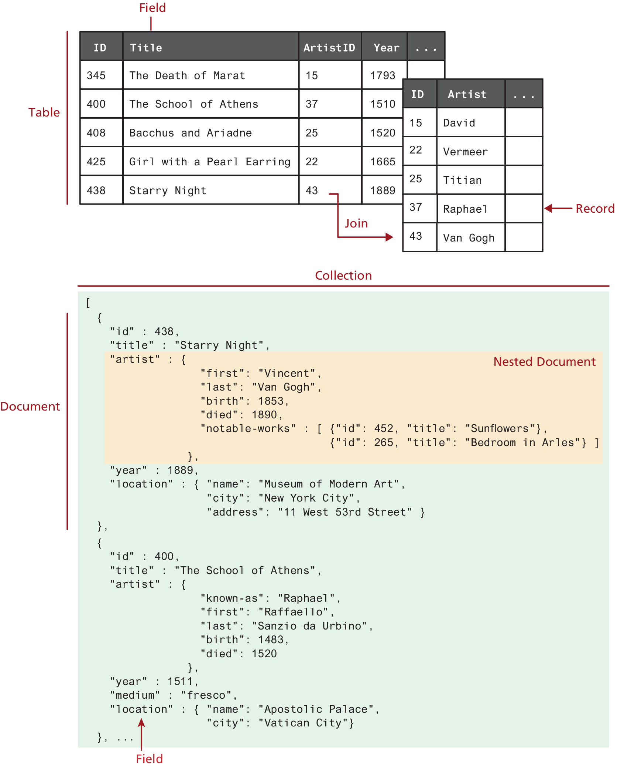
Comparing relational databases to the MongoDB data model

Slide 51
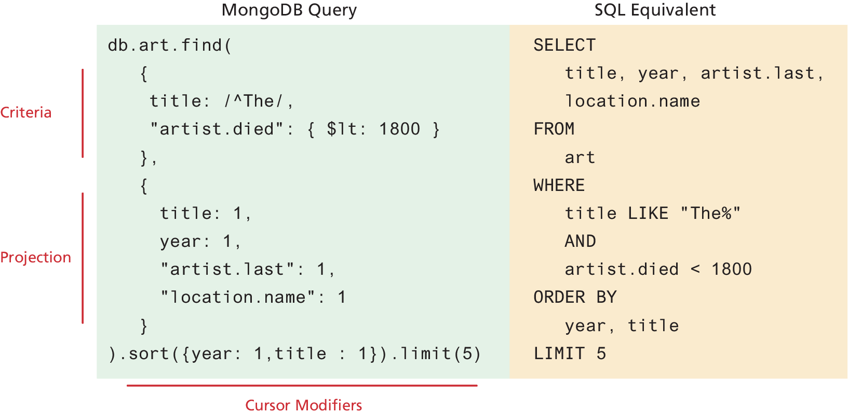
Comparing a MongoDB query to an SQL query

Slide 52
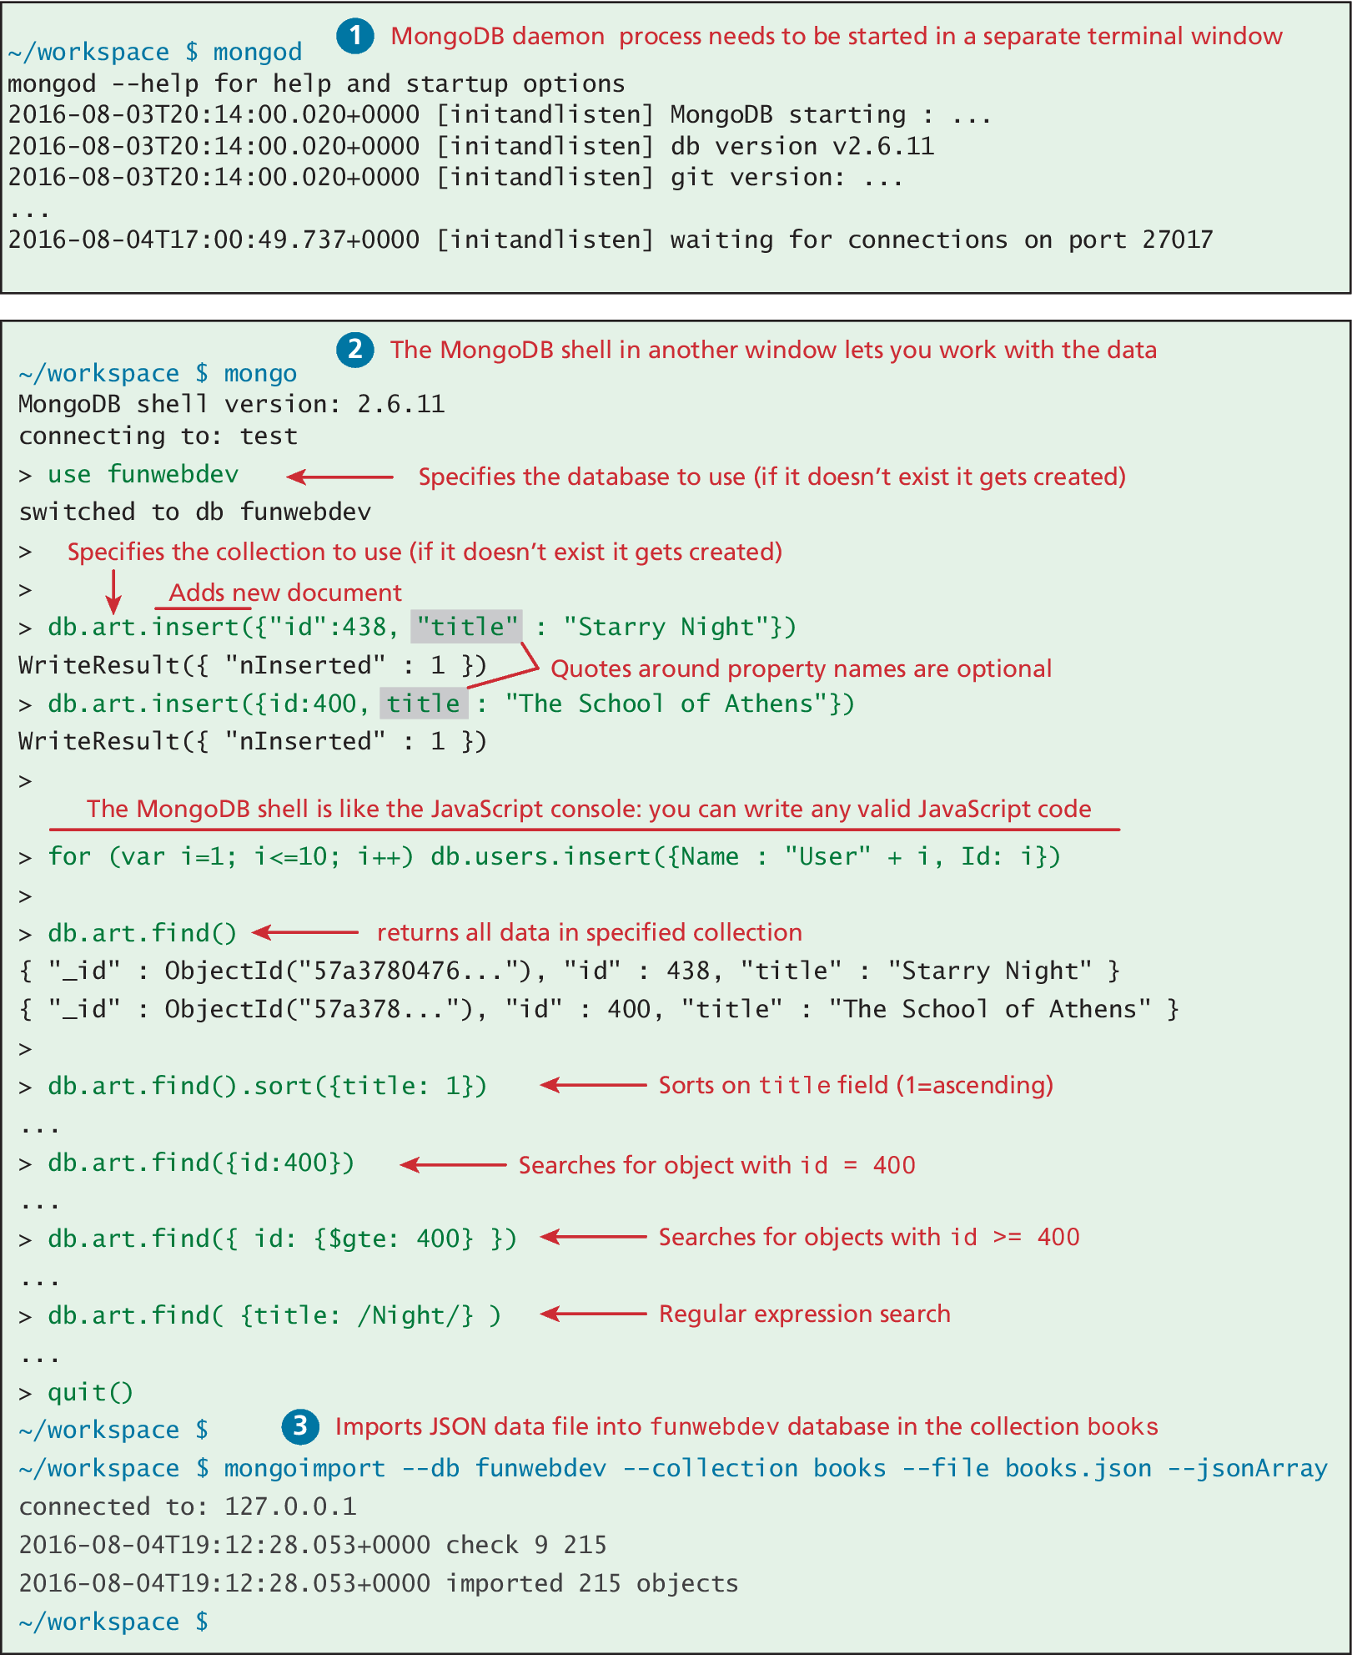
Working with the MongoDB Shell

Slide 53
Accessing MongoDB Data in Node.js
const mongoose = require('mongoose');
// define a schema that maps to the structure in MongoDB
const bookSchema = new mongoose.Schema({
id: Number,
isbn10: String,
isbn13: String,
title: String,
…
},
category: {
main: String,
secondary: String
}
});
// now create model using this schema that maps to books collection in database
module.exports = mongoose.model('Book', bookSchema,'books');
require('dotenv').config();
console.log(process.env.MONGO_URL);
const mongoose = require('mongoose');
mongoose.connect(process.env.MONGO_URL, {useNewUrlParser: true, useUnifiedTopology: true});
const db = mongoose.connection;
db.on('error', console.error.bind(console,
'connection error:'));
db.once('open', () => {
console.log('connected to mongo');
});
LISTING 14.23 Connecting to MongoDB using Mongoose
LISTING 14.24 Creating a Mongoose model

Slide 54
Web service using MongoDB
// get our data model
const Book = require('./models/Book.js’);
app.get('/api/books', (req,resp) => {
// use mongoose to retrieve all books
Book.find({}, function(err, data) {
if (err) {
resp.json({ message:
'Unable to connect to books' });
} else {
// return JSON retrieved by Mongo as response
resp.json(data);
}
});
});
app.get('/api/books/:isbn', (req,resp) => {
// use mongoose to retrieve all books from Mongo
Book.find({isbn10: req.params.isbn},
function(err, data) {
if (err) {
resp.json({ message: 'Book not found' });
} else {
resp.json(data);
}
});
});
LISTING 14.25 Web service using MongoDB data and Mongoose ORM

Slide 55
Key Terms
aggregate functions
binary tree
clickstream
column store
commodity servers
composite key
connection
connection string
database
data integrity
Data Definition Language
(DDL)
data duplication
database normalization
distributed transactions
document stores
failover clustering
fields
foreign key
GraphQL
graph store
hash table
index
inner join
join
key-value stores
local transactions
many-to-many
relationship
multiple-master
replication
MySQL
named parameter
NoSQL
one-to-many relationship
one-to-one relationship
ORM (Object-Relational
Mapping)
phpMyAdmin
prepared statement
primary key
query
record
result set
sanitization
sharding
single-master replication
SQL
SQL script
table
table gateway
transaction
two-phase commit

Slide 56

Copyright
This work is protected by United States copyright laws and is provided solely for the use of instructors in teaching their courses and assessing student learning. Dissemination or sale of any part of this work (including on the World Wide Web) will destroy the integrity of the work and is not permitted. The work and materials from it should never be made available to students except by instructors using the accompanying text in their classes. All recipients of this work are expected to abide by these restrictions and to honor the intended pedagogical purposes and the needs of other instructors who rely on these materials.

